Slide 1

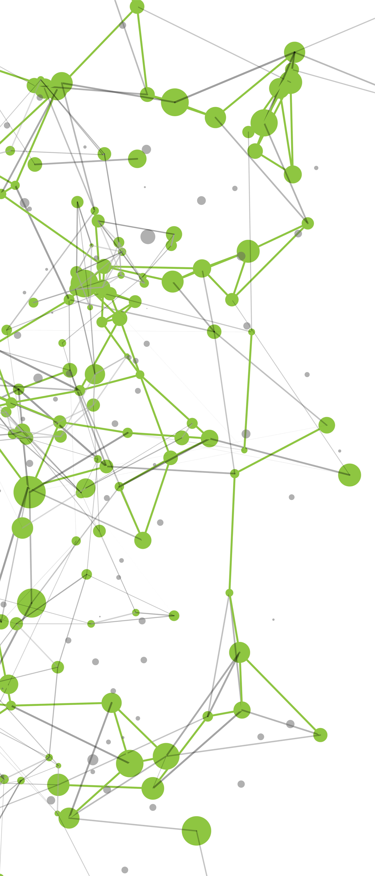


Slide 2


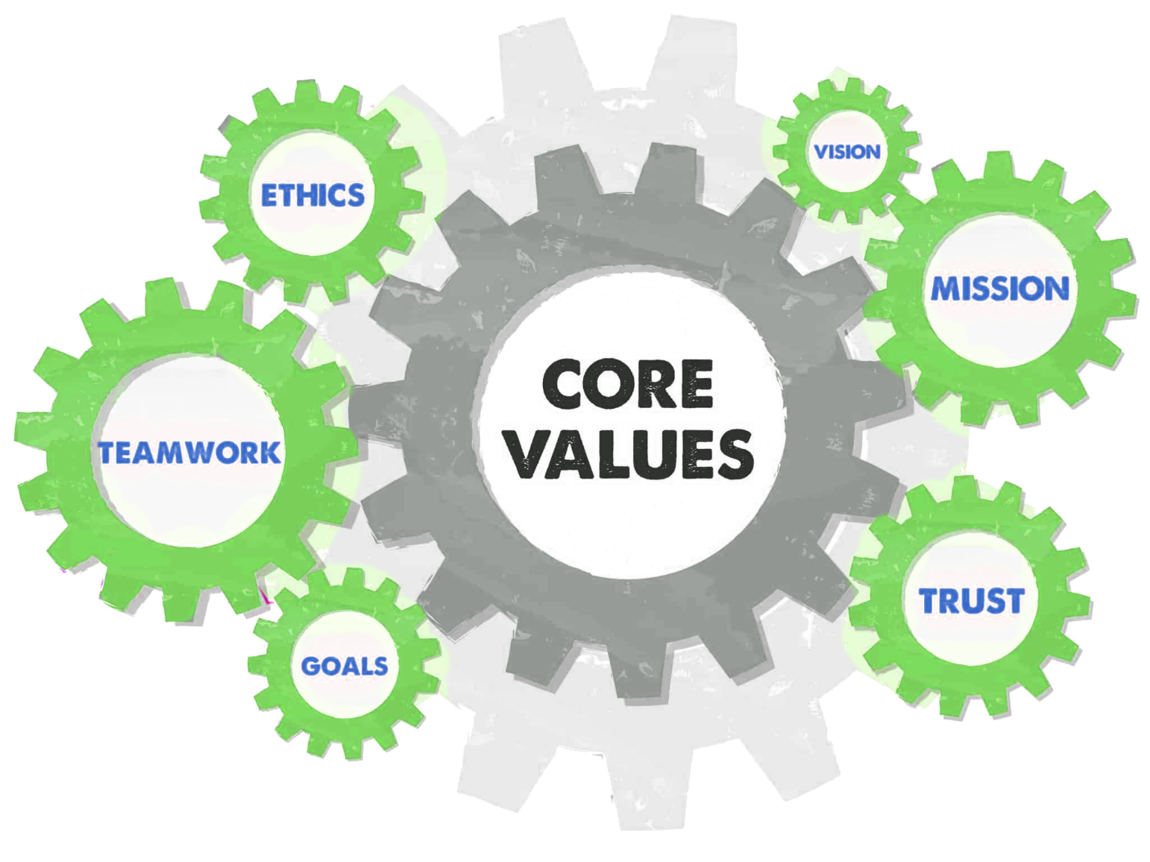
OUR VISION
We envision emerging as a pioneer in the Engineering Technology sector by delivering integrated sustainable engineering solutions.
OUR MISSION
Our mission is to provide creative, cost effective and practically achievable engineering solutions.
OUR VALUES
We standby and believe in what we profess.

Slide 3
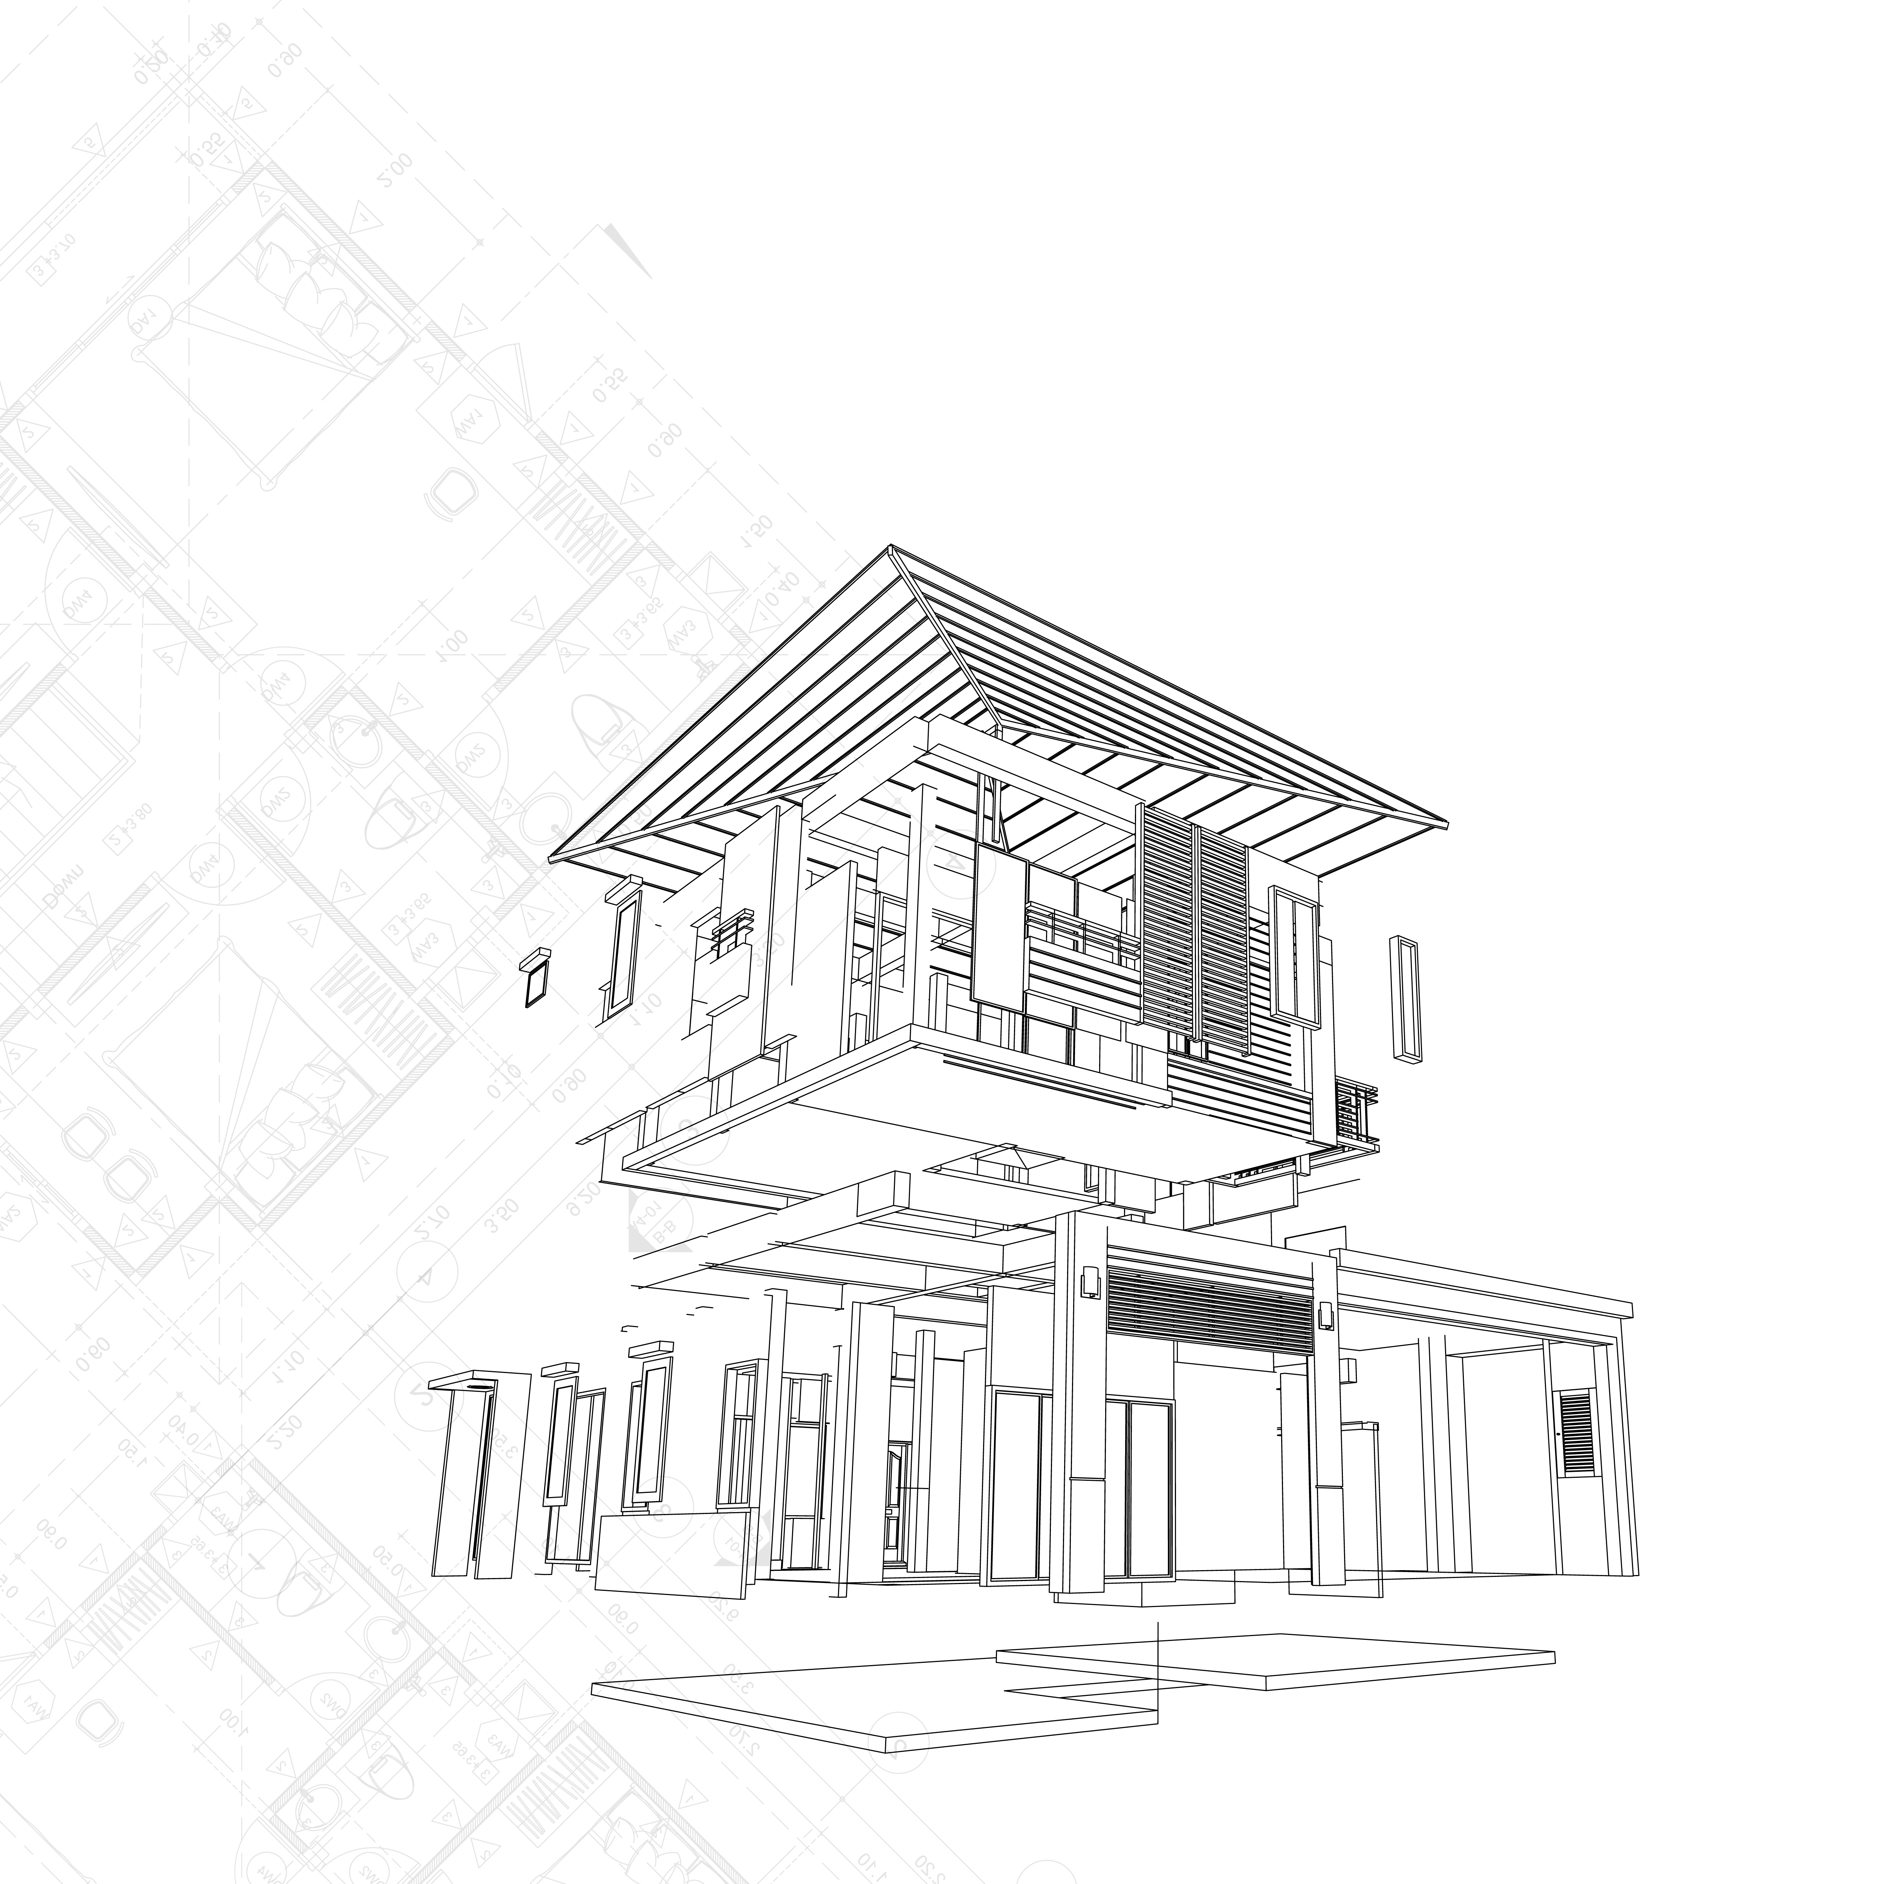
OUR STORY
The emergence of Building Information Modeling (BIM) in the construction industry has come with promises of improving efficiency in project delivery and asset management. BIM concerns the digitization of the building project by depending on information technology capabilities already achieved in various professional domains associated with different stages of the building life cycle.
At Beyond BIM, we provide a full range of architectural and multi-disciplinary engineering services. These services cater to all the stakeholders in a typical built environment - the Developer / Owner, Design Consultants & the Contractor / Fabricator with extensive experience on BIM implementation on large scale complex projects.
.

Slide 4
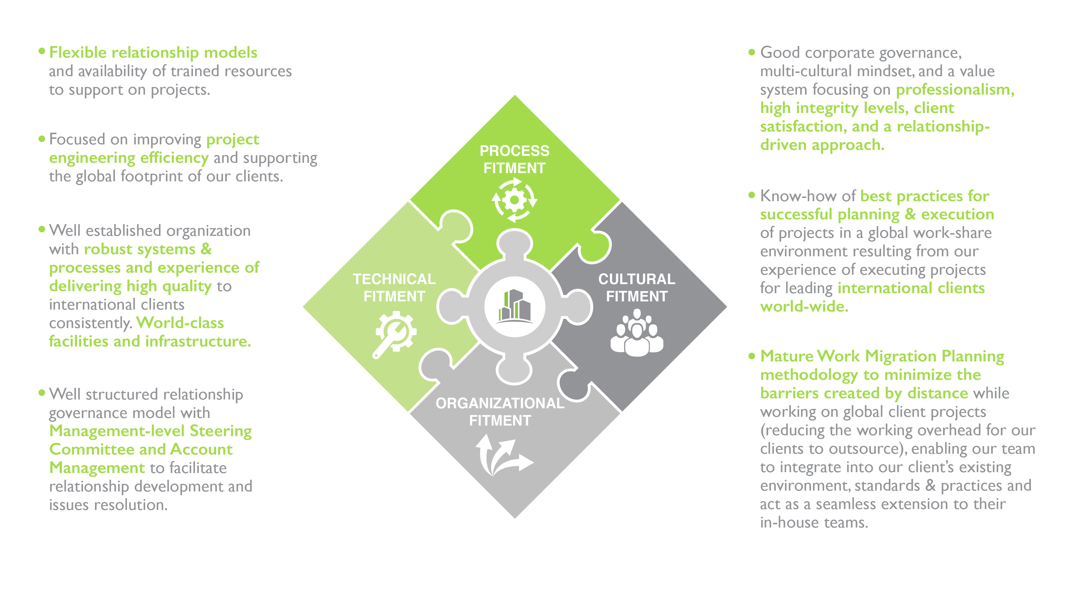
OUR VALUE PROPOSITION

Slide 5
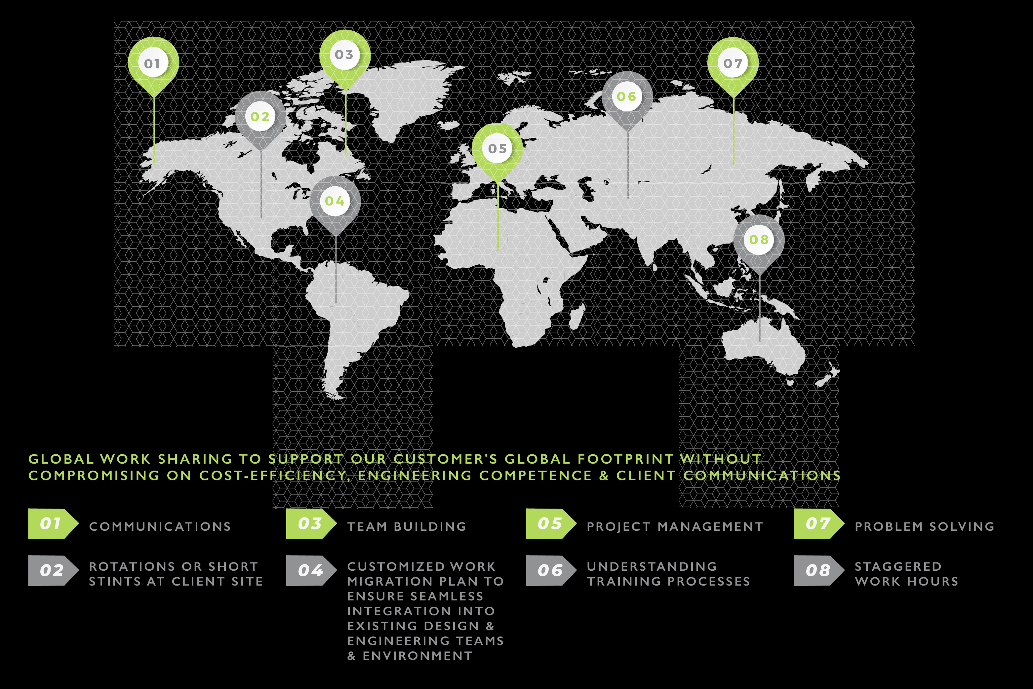
MINIMIZING BARRIERS CREATED BY DISTANCES…

Slide 6
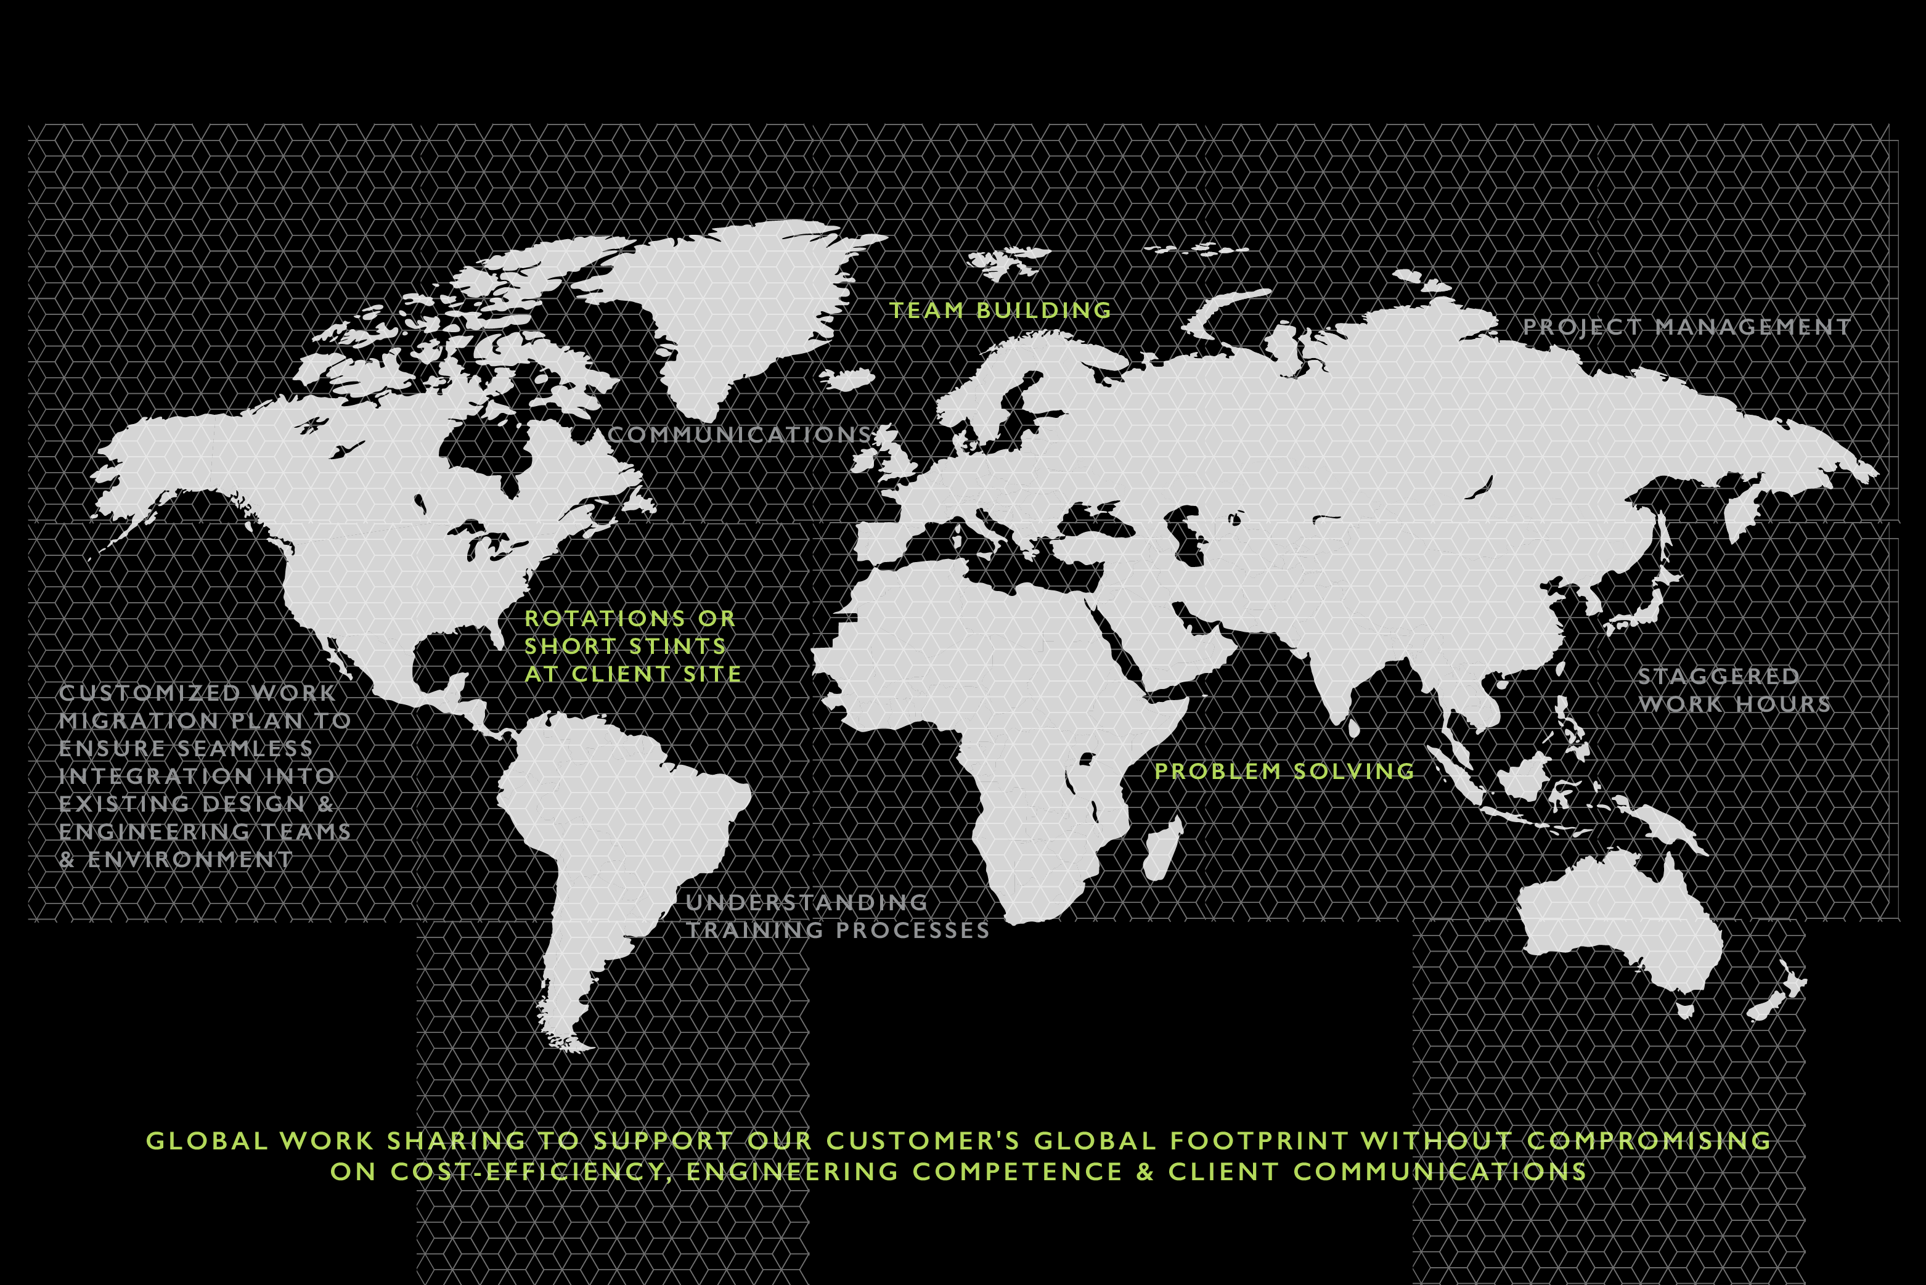
MINIMIZING BARRIERS CREATED BY DISTANCES…

Slide 7
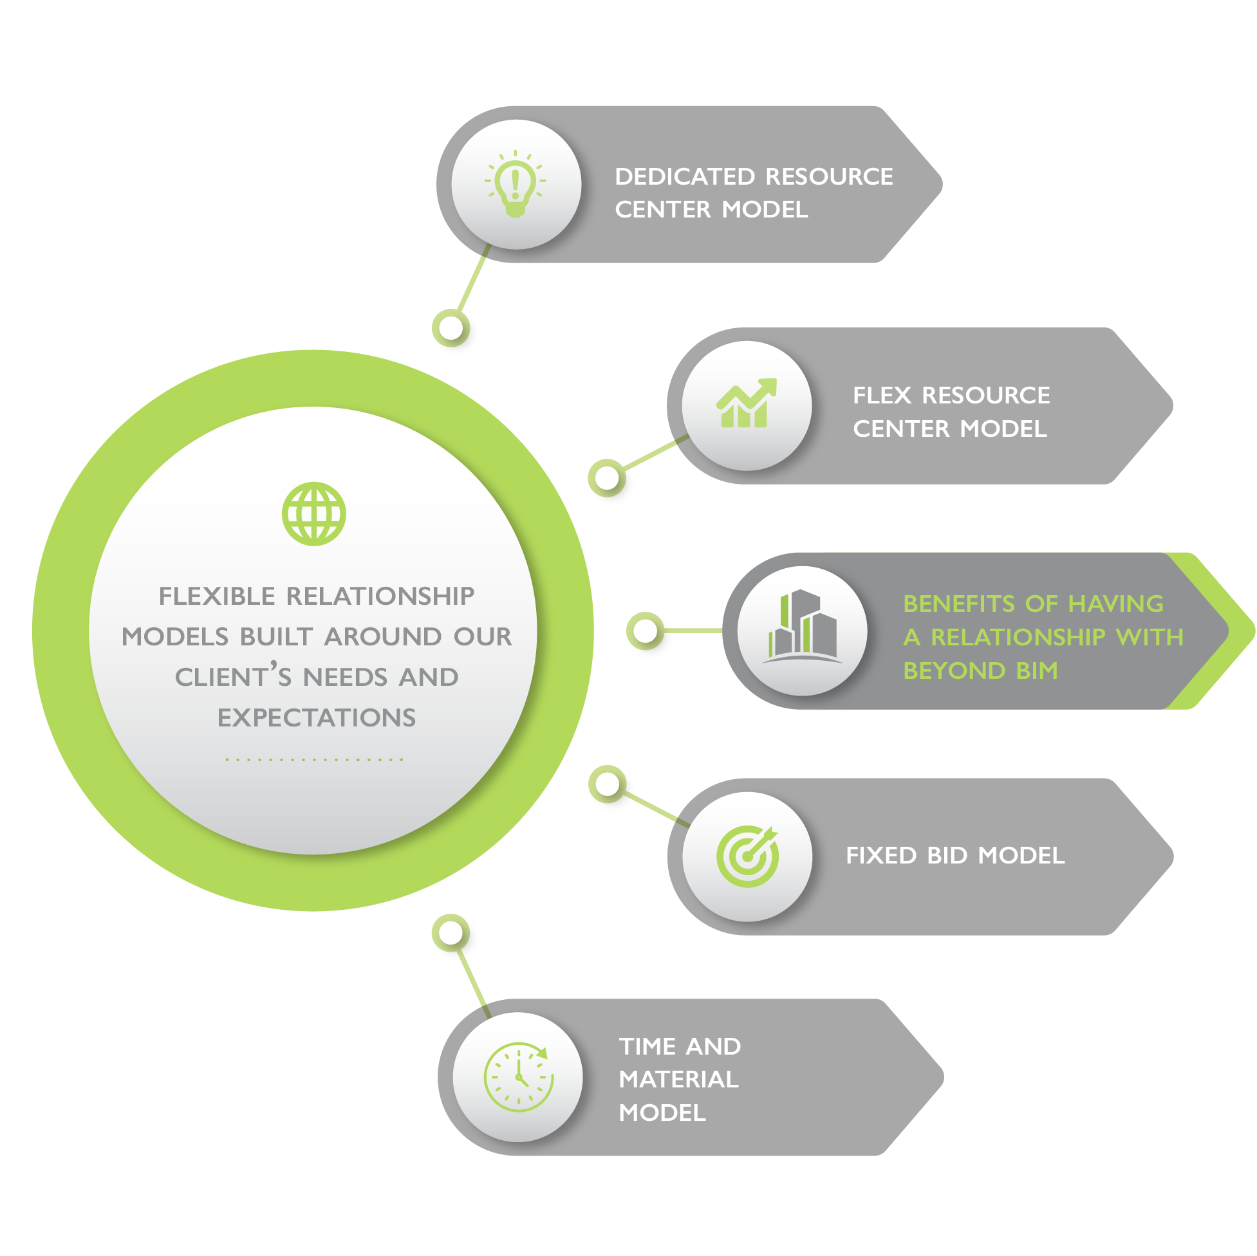
Increase competitiveness and bottom-line: Lower cost structure at reduced risks
Utilize in-house core resources on higher value generating activities (increase revenue per employee and reduce employee cost as a % of revenues)
Lean operations and flexible resourcing (Convert fixed expenses into variable expenses)
Reduced overheads and capex / working capital requirements
Higher level of detailed engineering to reduce construction costs / errors
Ability to better address emerging market requirements
Global footprint support leveraging a hybrid delivery model

Slide 8
STATE-OF-THE-ART COMMUNICATION INFRASTRUCTURE
Certified for compliance to security standards having 133 control objectives across 11 domains:
Security policy
Organization of information security
Asset management
Human resources security
Physical and environmental security
Access control
Information systems acquisition
Development and maintenance
Communications & Operations management
Information security incident management
Business continuity management and compliance

Slide 9
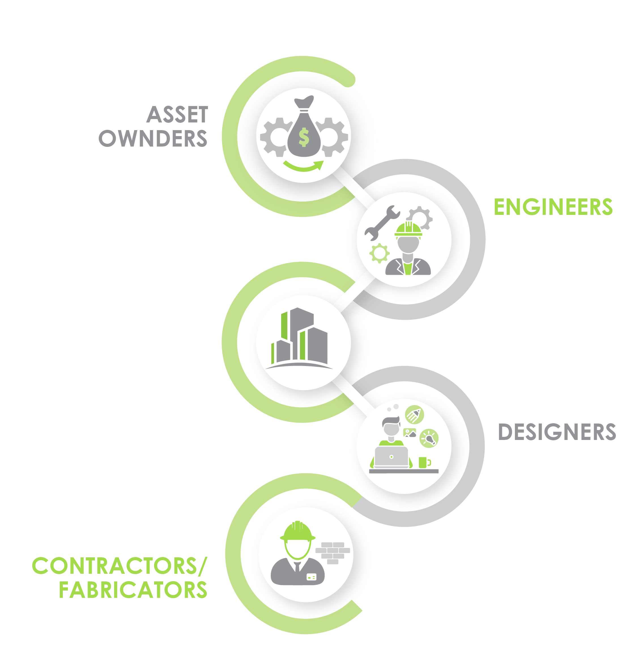
OUR CLIENTELE
At Beyond BIM, we cater to the following entities.

Slide 10
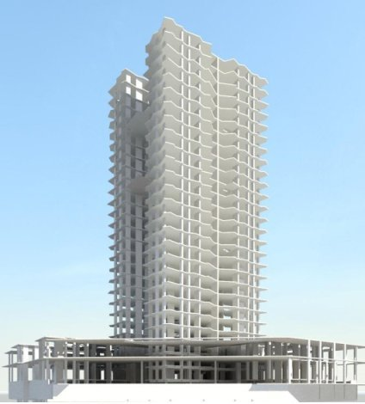
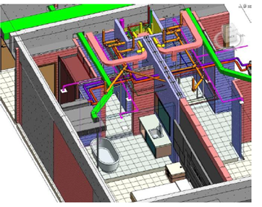
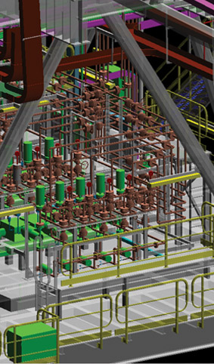
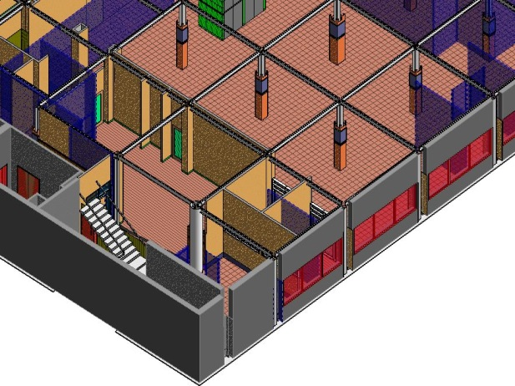
OUR SERVICES
BIM Consulting & Implementation Services
BIM Program Management
BIM Consultancy Management & BEP Development
Design Visualization and Validation (3D)
Clash detection and resolution (CDR)
Construction simulation (4D)
Quantity (Materials) takeoffs (BOQ)
Cost Monitoring & Material Procurement (5D)
BIM for Sustainability (6D)
BIM for Facilities Management (7D)
Coordinated Construction Documentation (2D)
Pre-Construction Site Logistics
BIM Model Auditing/Inspection
Constructability Review & Analysis
BID Presentation and Walkthroughs
3D Laser scanning and Scan to BIM

Slide 11
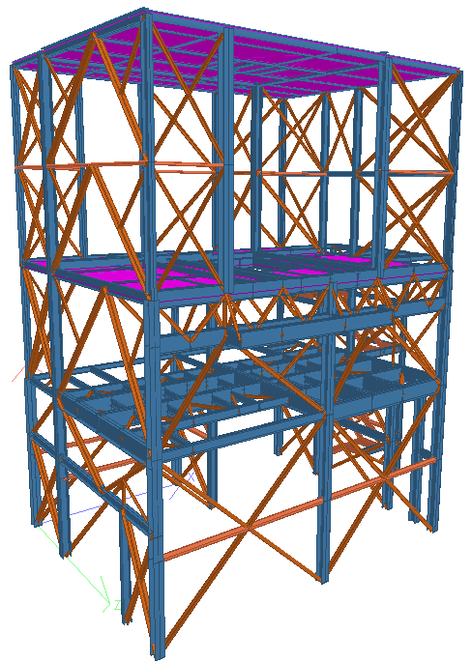
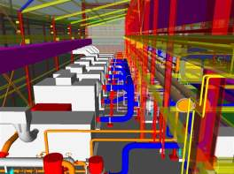
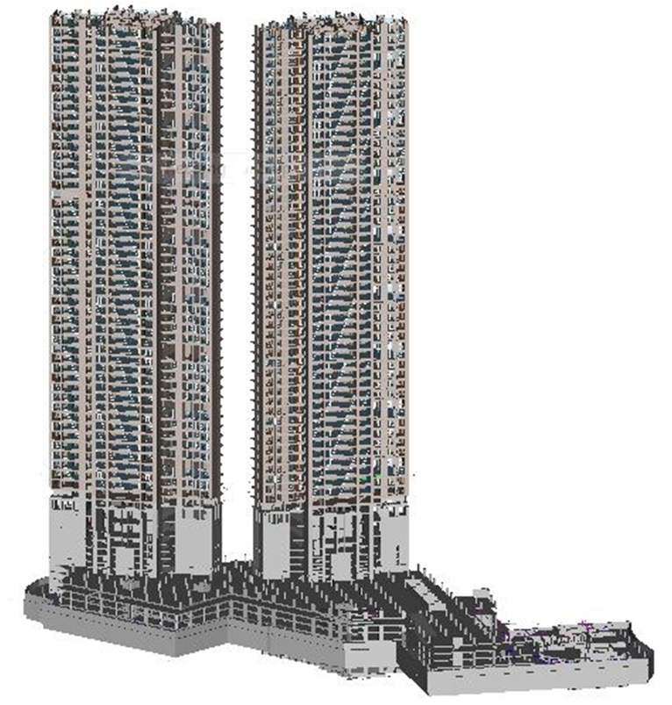
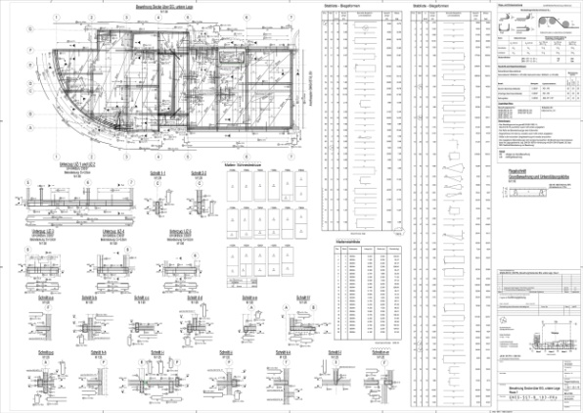
OUR SERVICES
Detail Design and Production Documentation
Steel Detailing
Rebar Detailing and preparation of BBS
Preparation of Spool Drawings/Fabrication Drawings
CAD conversion and Vectorization (Raster to Vector conversion)
Creation of Dynamo Scripts for Revit
LISP creation for AutoCAD

Slide 12
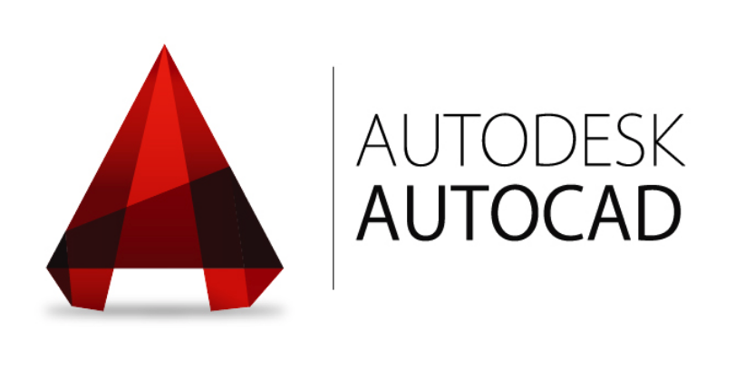
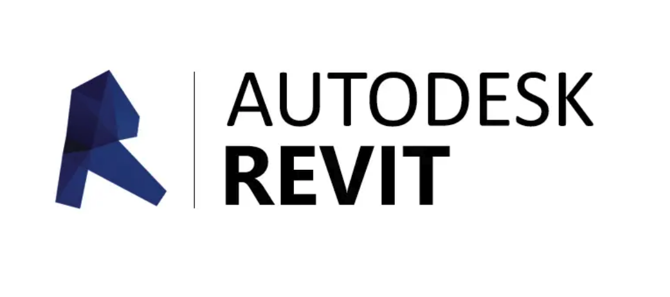
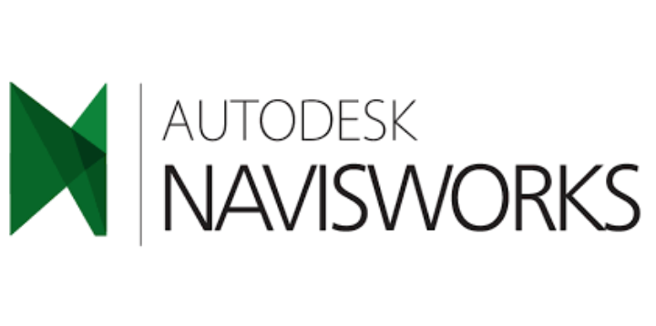
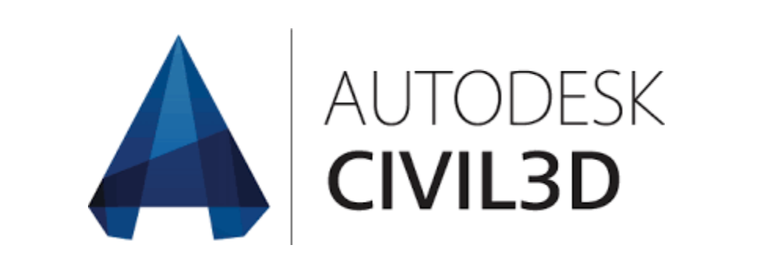









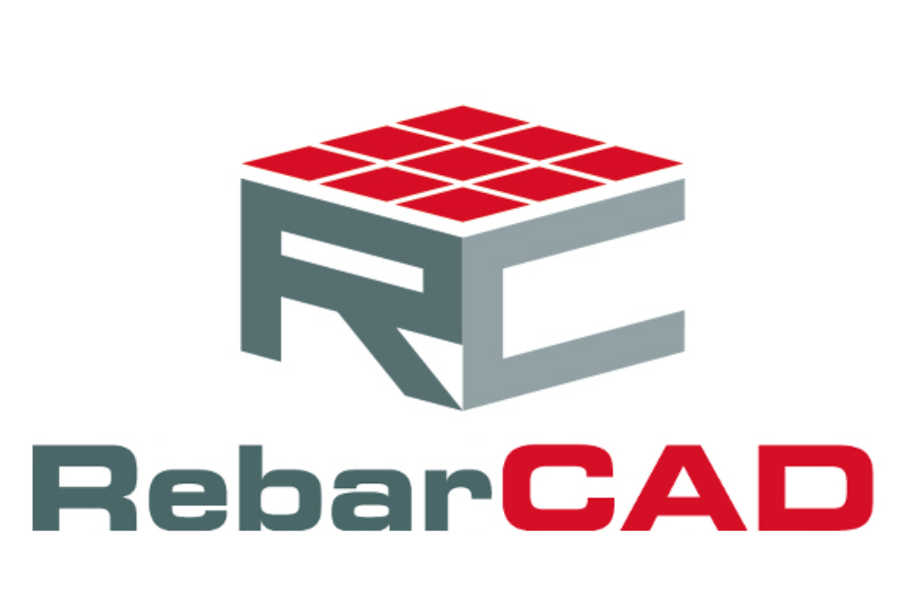
OUR TOOLS
Autodesk AutoCAD
Autodesk Revit
Autodesk Navisworks
Autodesk Civil 3D
Autodesk InfraWorks
Autodesk AutoCAD MEP
Autodesk Fabrication (CADmep & CAMduct)
Autodesk 3ds Max
Bentley AECOsim Building Designer
Bentley OpenRoads Designer
Tekla
STAAD Pro
CADPIPE
RebarCAD
CADS RC

Slide 13

PROJECT CASE STUDIES
The members of our core team have spearheaded the following projects.

Slide 14
CASE STUDY Qetaifan Islands South | Qatar
The project involved the of development of Infrastructure, Utilities, landscaping and Highways for 3 artificial islands spanning an area of 6 square kms.
Scope of work involved: Creating federated and fully coordinated Building Information Models involving the following activities:
Develop the BIM Execution Plan and BIM QA/QC Plan
Provide the central communication link between various disciplines, design teams and construction teams
Generate a federated and fully coordinated BIM model
Clash Detection and Resolution
Extraction of Shop drawings
4D Simulation
5D material and procurement management
As-Built development including site verification of elements using 3D Laser Scanning

Slide 15
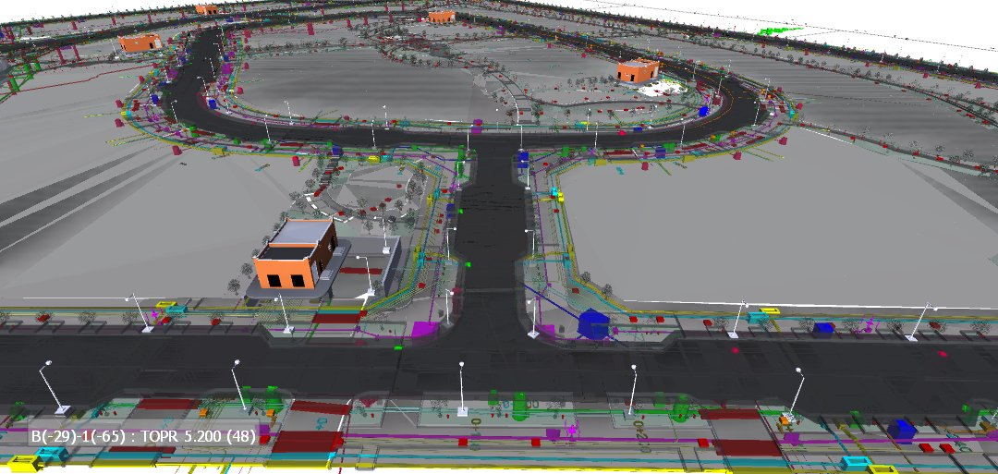
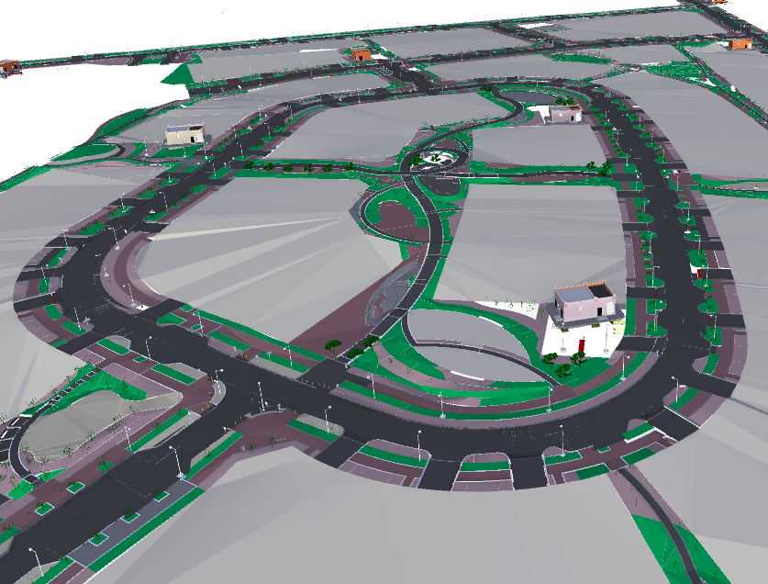
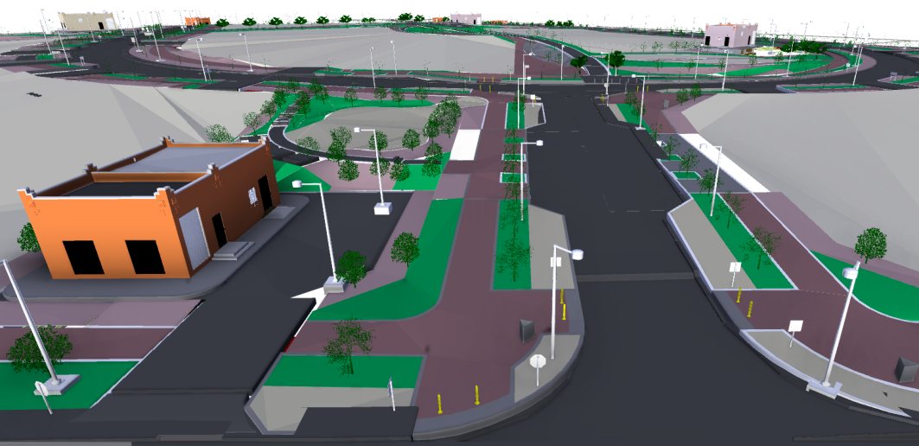
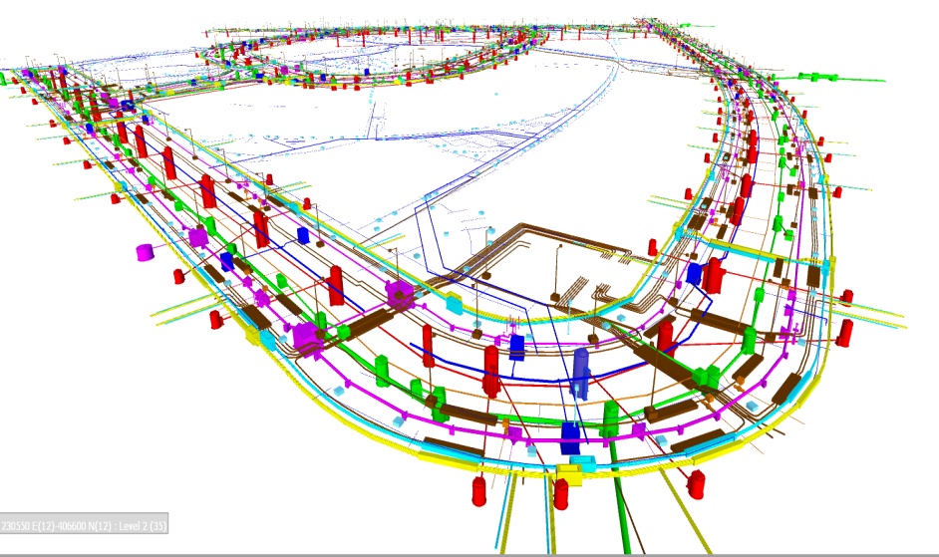
CASE STUDY Qetaifan Islands South | Qatar

Slide 16
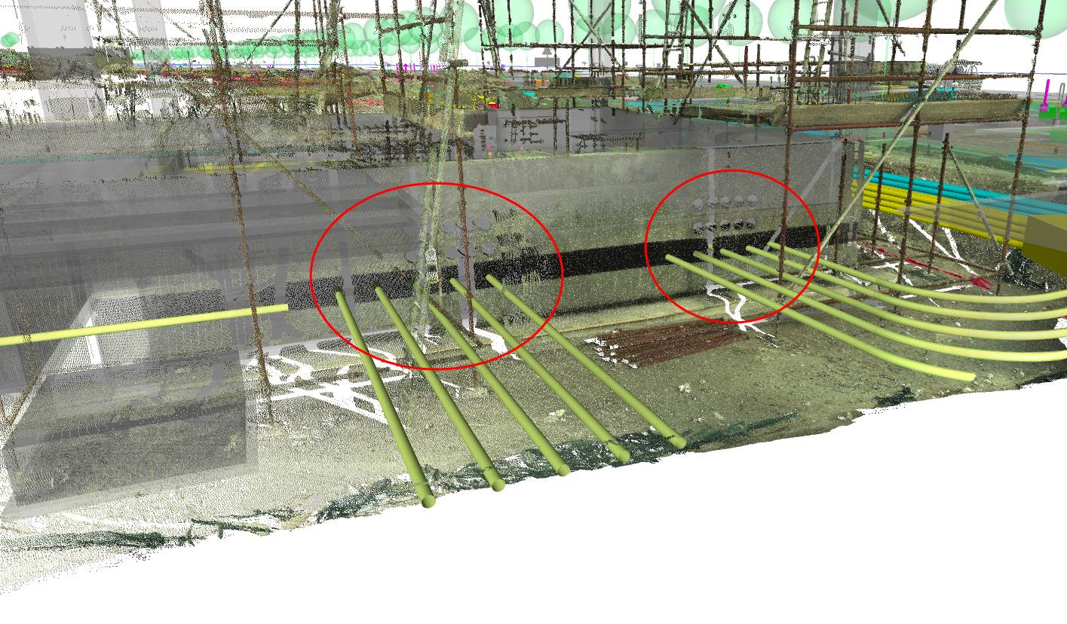
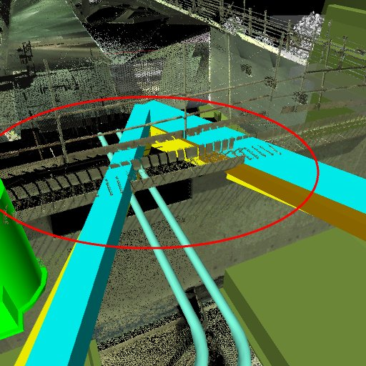
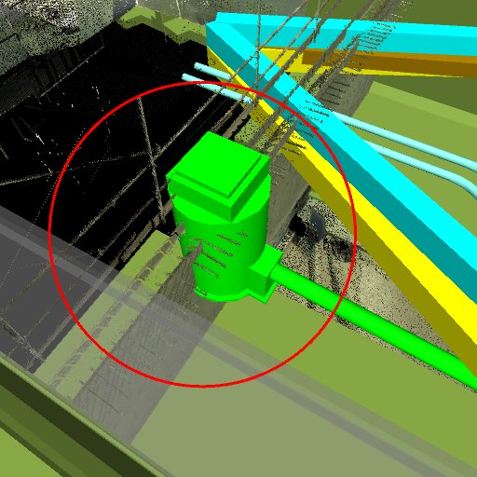
CASE STUDY Qetaifan Islands South | Qatar
Site verification of elements using 3D Laser Scanning to develop an LOD 500 fully As-Built Model

Slide 17
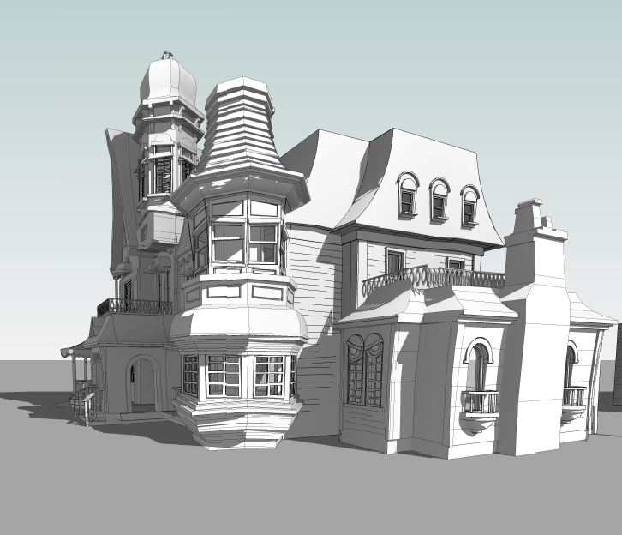
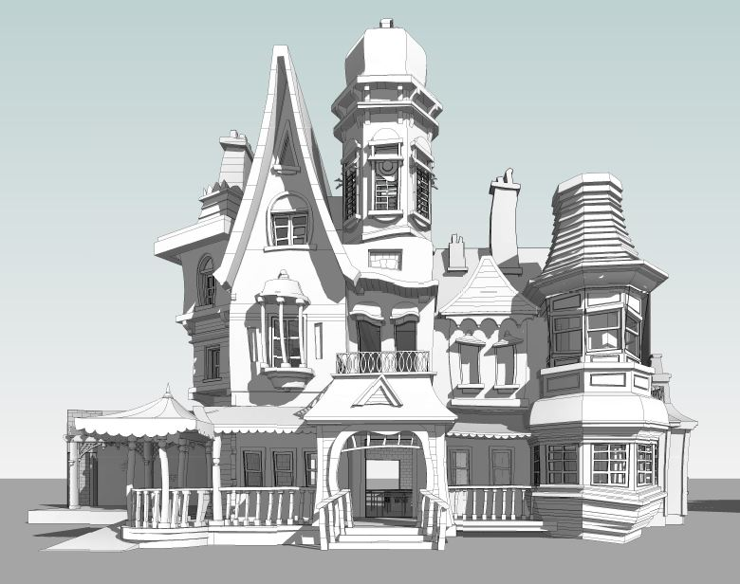
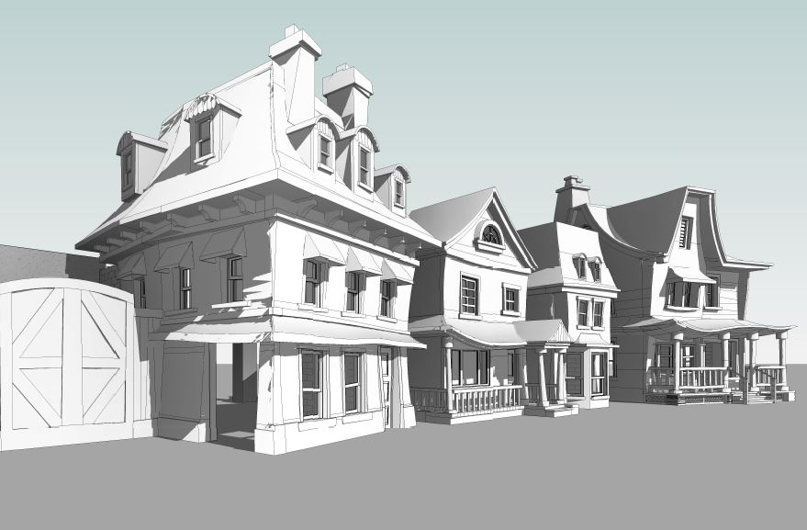
CASE STUDY Warner Bros. Theme Park | U.A.E
Scope of work involved:
Developing the design stage architectural model for extremely complicated shapes as seen in the images

Slide 18
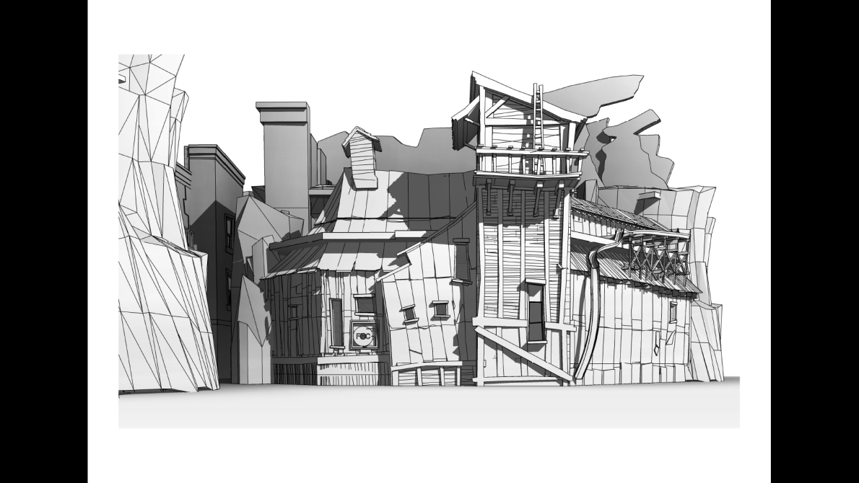
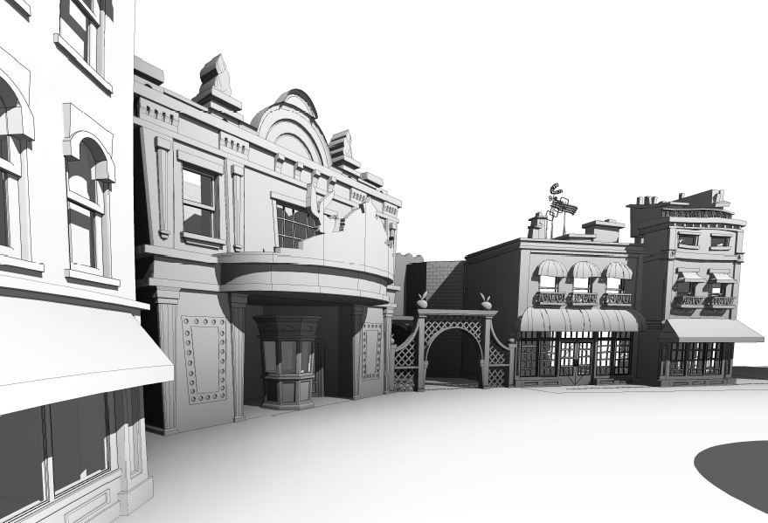
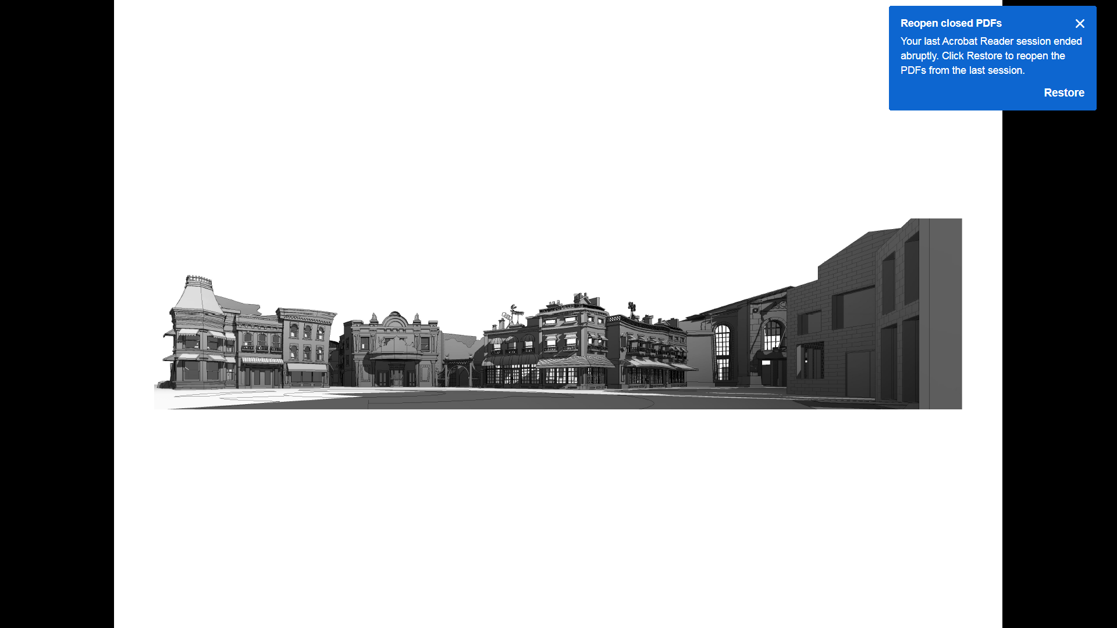
CASE STUDY Warner Bros. Theme Park | U.A.E

Slide 19
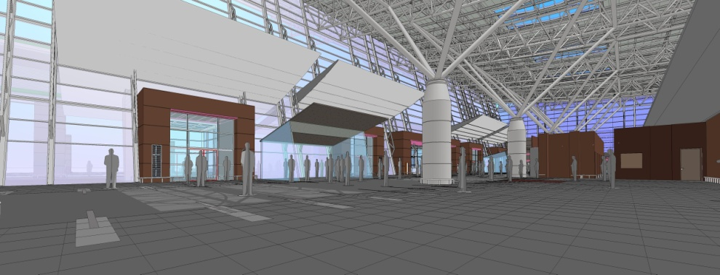
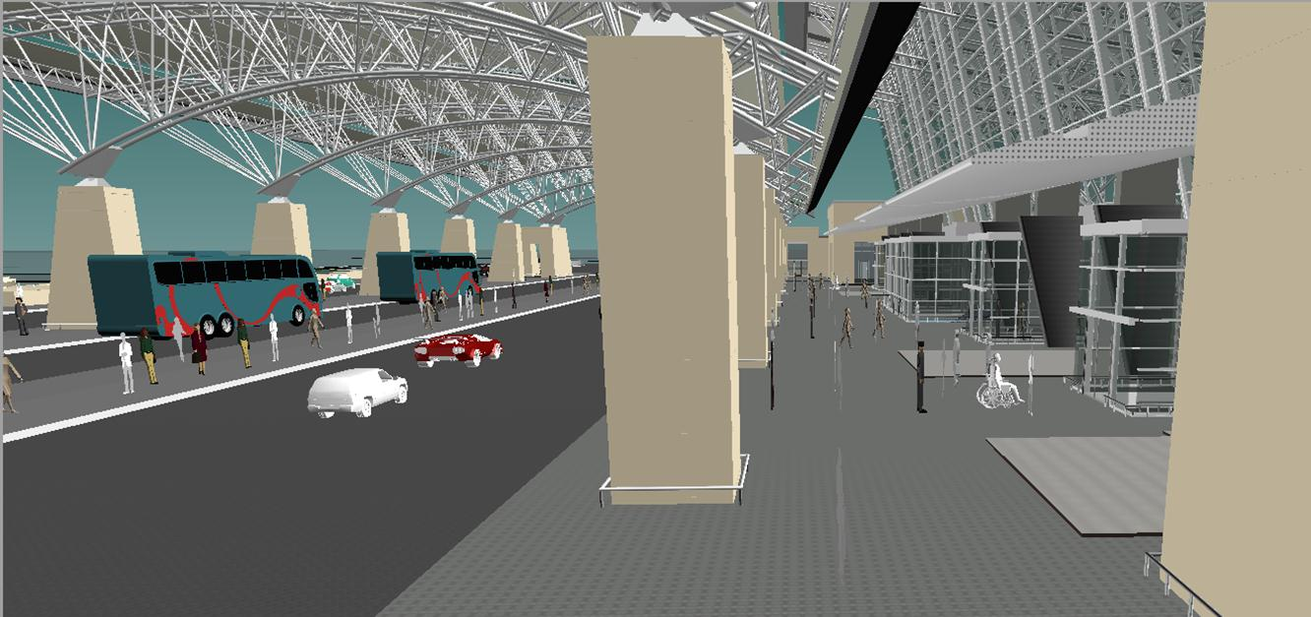
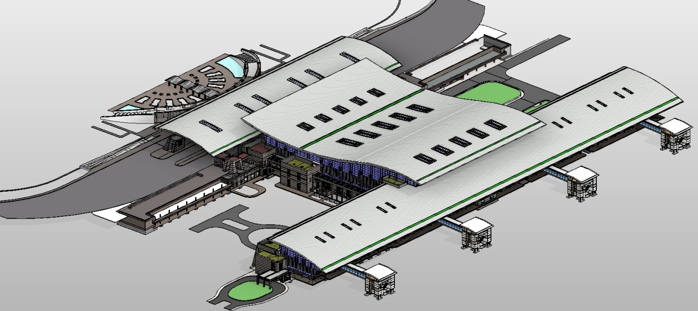
CASE STUDY Salalah International Airport | Oman
Scope of work involved:
Developing the LOD 400 and LOD 500 BIM model for all services (Architecture, Structure, MEP and Site works)
Developing the Bill of Quantity (B.O.Q), Bill of Material (B.O.M), Clash detection & clash resolution and preparation of 2D Shop and As-Built drawings.
Upon completion, the model was updated with COBie information for Facilities Management.

Slide 20
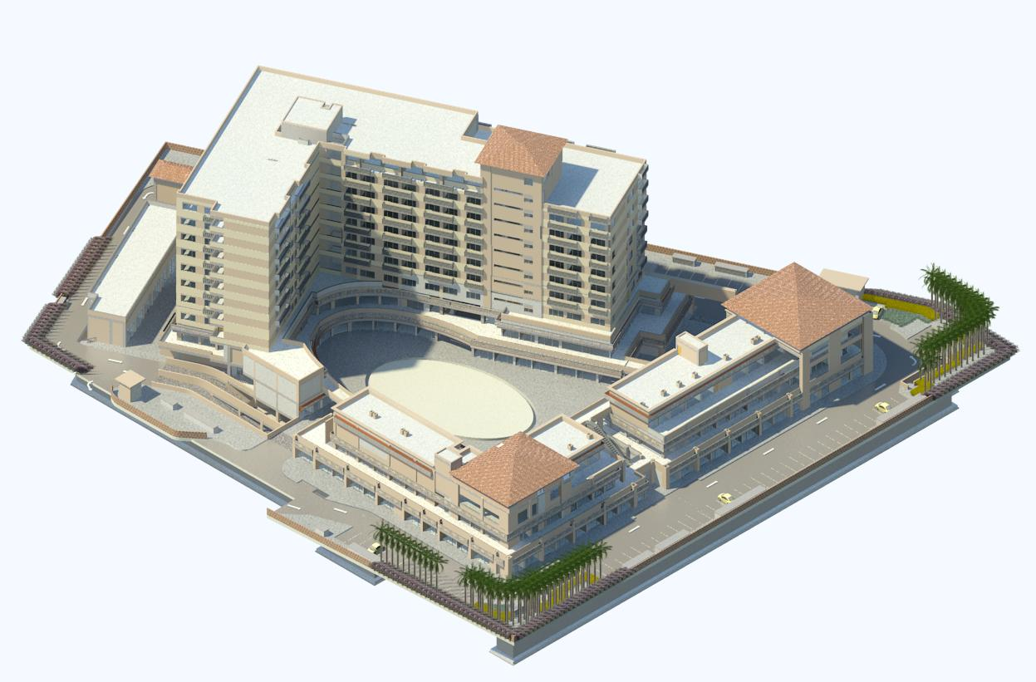
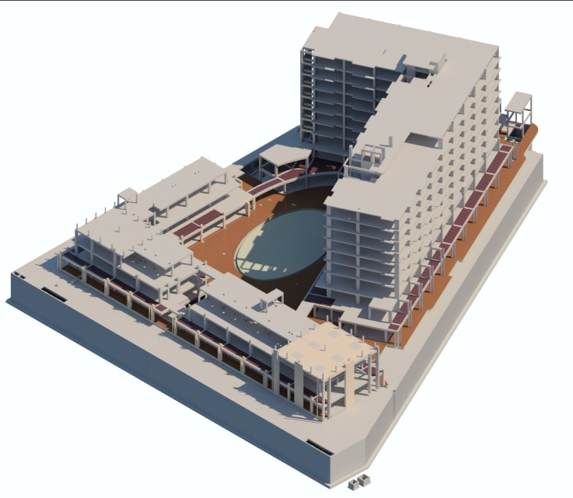
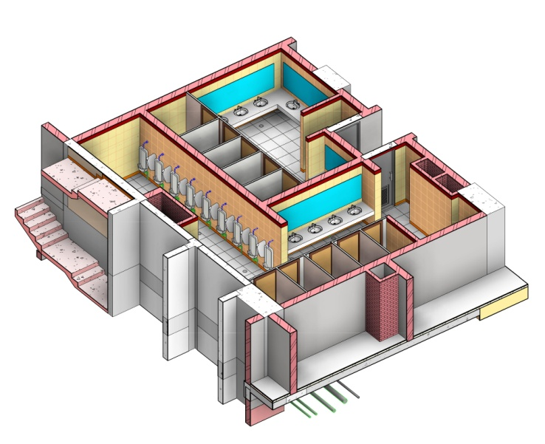
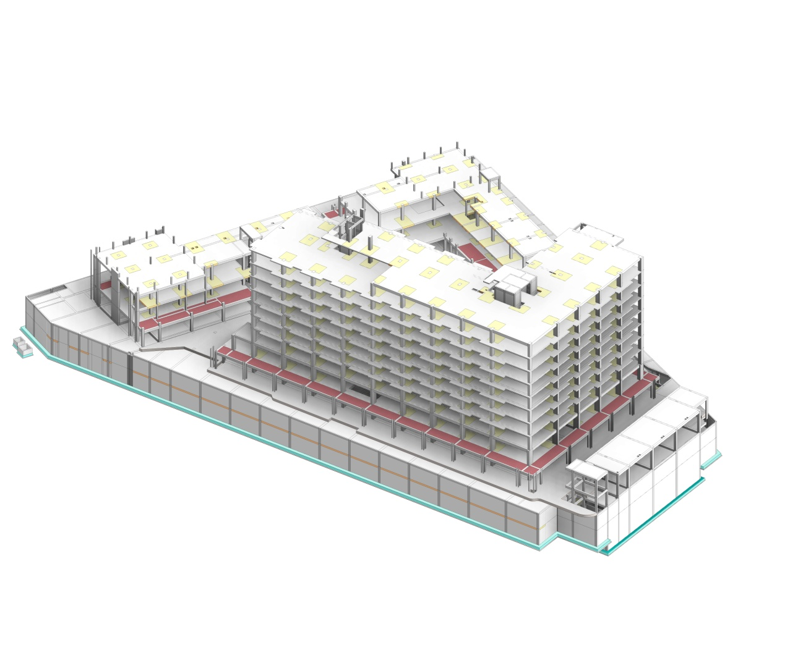
CASE STUDY Emerald Plaza | India
The project is a street-style retail and SOHO format spaces development spread over four acres of land. It houses three floors of retail space and eight floors of office space.
Scope of work involved:
Developing the LOD 400 model for all services (Architecture, Structure, MEP and Site works)
Developing the Bill of Quantity (B.O.Q), Bill of Material (B.O.M), Clash detection & clash resolution and preparation of 2D Shop drawings

Slide 21
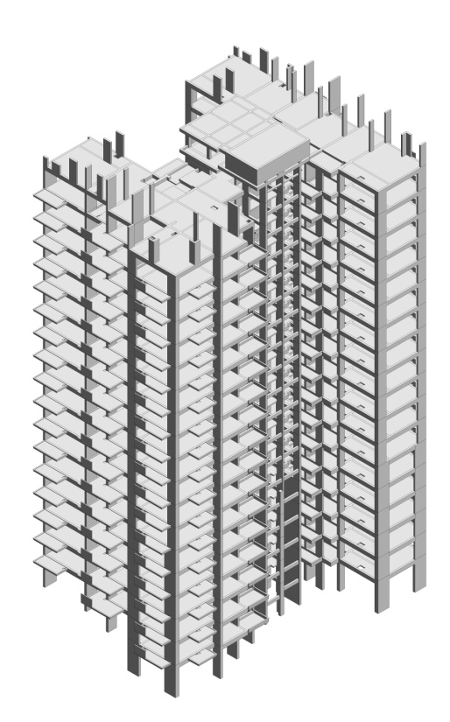
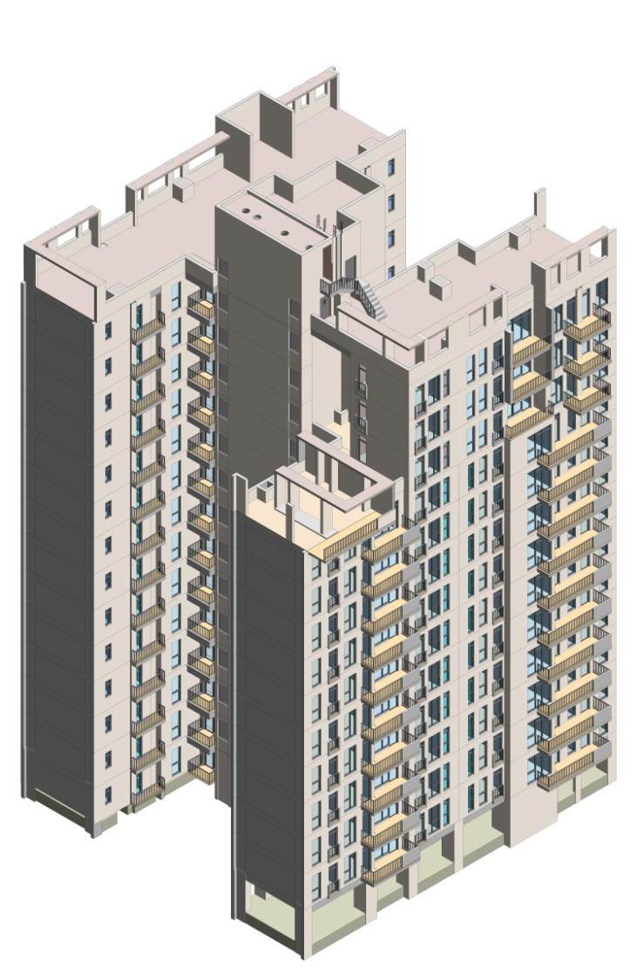
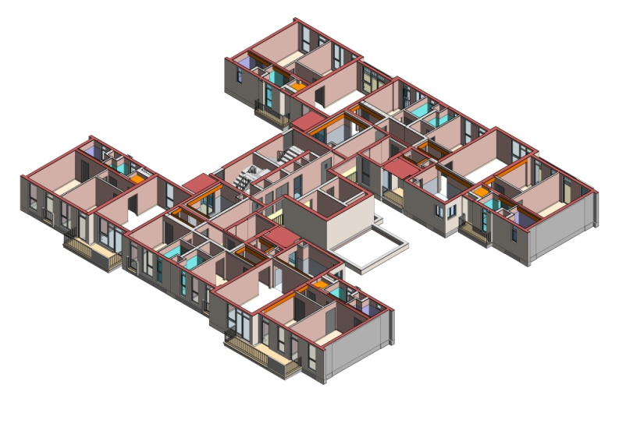
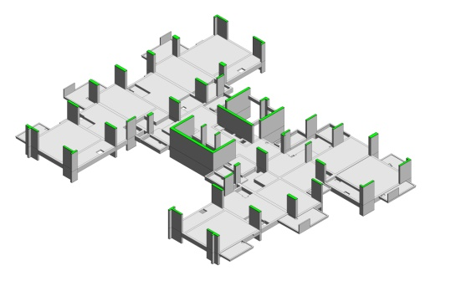
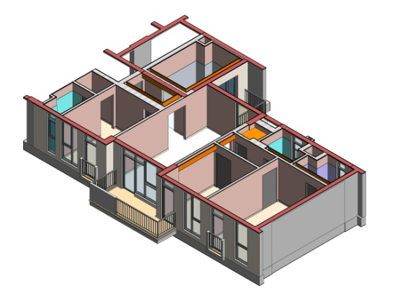
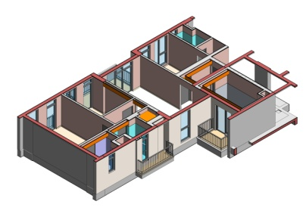
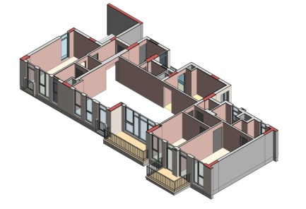
CASE STUDY The Corridors by IREO | India The project is gaited residential compound spread over 35 acres.
Scope of work involved:
Developing the LOD 400 model for Architectural and Structural services
Developing the Bill of Quantity (B.O.Q)

Slide 22
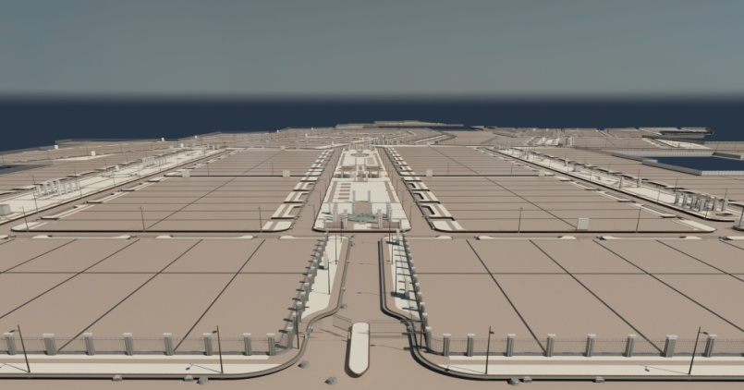
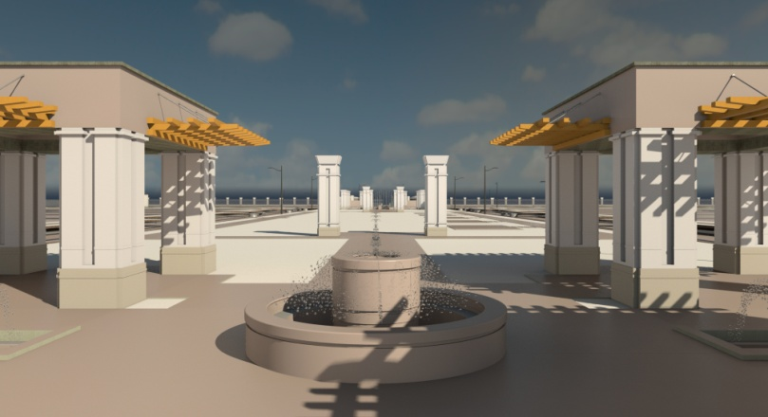



CASE STUDY DLF Alameda | India
Scope of work involved:
Developing the LOD 400 model for Infrastructure, utilities and Site works
Developing the Bill of Quantity (B.O.Q), Clash detection & clash resolution and preparation of 2D Shop drawings

Slide 23




CASE STUDY
Nanyang Technological University | Singapore Nanyang Technological University (NTU) is one of the largest public universities in Singapore. Its lush 200-hectare Yunnan Garden campus was the Youth Olympic Village of the world's first 2010 Summer Youth Olympics in 2010.
Scope of work involved:
Developing Architectural & Structural model and generating the Bill of Quantity (B.O.Q)

Slide 24




CASE STUDY Detail Engineering for Ship to Shore Crane project | India
Scope of work involved:
Developing Architectural & Structural model and generating the Bill of Quantity (B.O.Q)
Notes:
Kone cranes

Slide 25







CASE STUDY Emiri Terminal | India
Scope of work involved:
Developing the LOD 400 model for Infrastructure, utilities and Site works
Developing the Bill of Quantity (B.O.Q), Clash detection & clash resolution and preparation of 2D Shop drawings

Slide 26
CASE STUDY Emiri Terminal | India
Scope of work involved:
Developing the LOD 400 model for Infrastructure, utilities and Site works
Developing the Bill of Quantity (B.O.Q), Clash detection & clash resolution and preparation of 2D Shop drawings

Slide 27


THANK YOU

